Slide 1
Online Examination System in C++
TEAM MEMBERS
A25126510025
K.SREE HARSHA
A25126510018
J.V.S JASWANTH
A25126510011
G.C.K.ADHITYA
A25126510021
K.LOHITH

Slide 2
PROBLEM STATEMENT
Traditional examination systems are mostly paper-based and require manual effort for conducting exams, evaluating answer sheets, and maintaining records. This process is time-consuming, prone to human errors, and inefficient when handling a large number of students.
There is also a lack of instant result generation, secure data management, and proper time monitoring during exams. Managing question papers and maintaining confidentiality is another major challenge.
Hence, there is a need for a computerized system that can automate the entire examination process, ensure accuracy, reduce manual workload, and provide quick and reliable results.

Slide 3
OBJECTIVE
To automate the examination process
To reduce manual evaluation
To generate quick results
To ensure secure login
To manage question data efficiently

Slide 4
Project Overview
Console-based Online Examination System with timer functionality
Two user roles: Admin (creates questions) and Student (takes exam)
Questions stored in questions.txt for persistent storage
Per-question timer enforces time limits automatically
Automatic scoring with correct/wrong answer feedback
Built using Object-Oriented Programming (OOP) principles

Slide 5
Header Files & Namespaces
CODE
EXPLANATION
#include<iostream>
#include<fstream>
#include<vector>
#include<string>
#include<ctime>
using namespace std;
<iostream> – Console I/O (cin, cout)
<fstream> – File operations (read/write questions)
<vector> – Dynamic array to store questions
<string> – String data type for text
<ctime> – Time functions (time_t, time(0))
using namespace std; avoids 'std::' prefix

Slide 6
Class: user – Login System
CODE
EXPLANATION
class user{
public:
int adminlogin(){
string u,p;
cin>>u; cin>>p;
if(u=="admin" && p=="admin123")
return 1;
cout<<"invalid"; return 0; }
int stulogin(){
string u,p;
cin>>u; cin>>p;
if(u=="student" && p=="stu123")
return 1;
cout<<"invalid"; return 0; }
};
Two methods: adminlogin() and stulogin()
Hardcoded credentials for simplicity
Admin: 'admin' / 'admin123'
Student: 'student' / 'stu123'
Returns 1 (success) or 0 (failure)
In real apps, use hashed passwords & DB
Return value controls access in main()

Slide 7
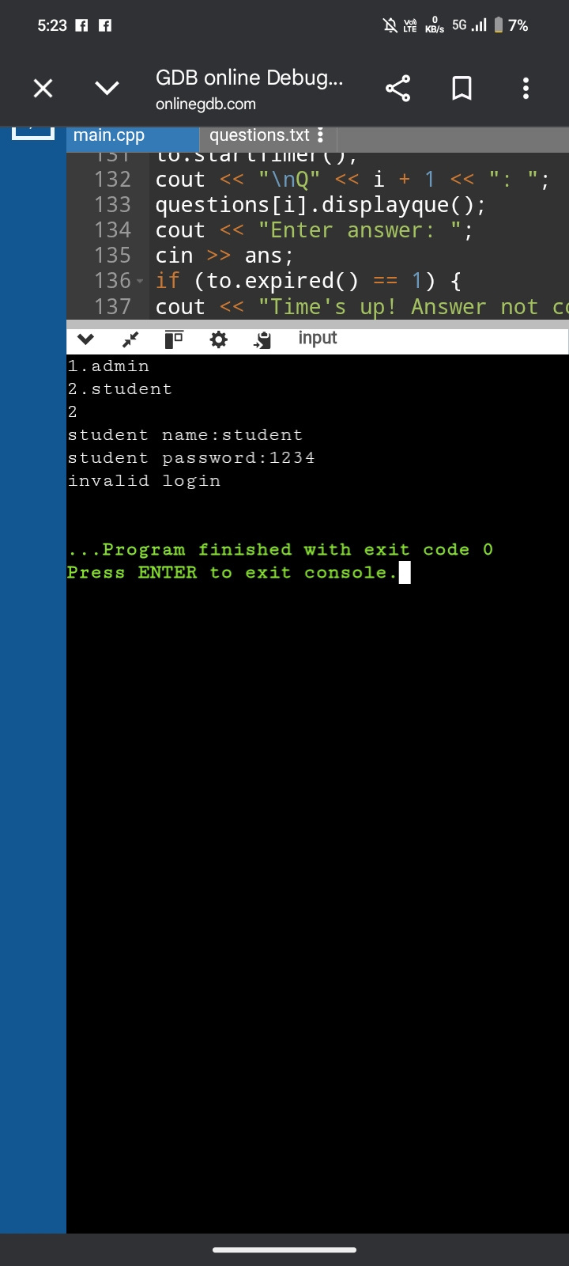
Output 1: Invalid Student Login
EXPLANATION
User selects option 2 (Student)
Enters username: student (correct)
Enters password: 1234 (WRONG!)
Correct password is 'stu123'
Program outputs: 'invalid login'
stulogin() returns 0, so exam does NOT start
Program exits with code 0 (normal termination)

Slide 8
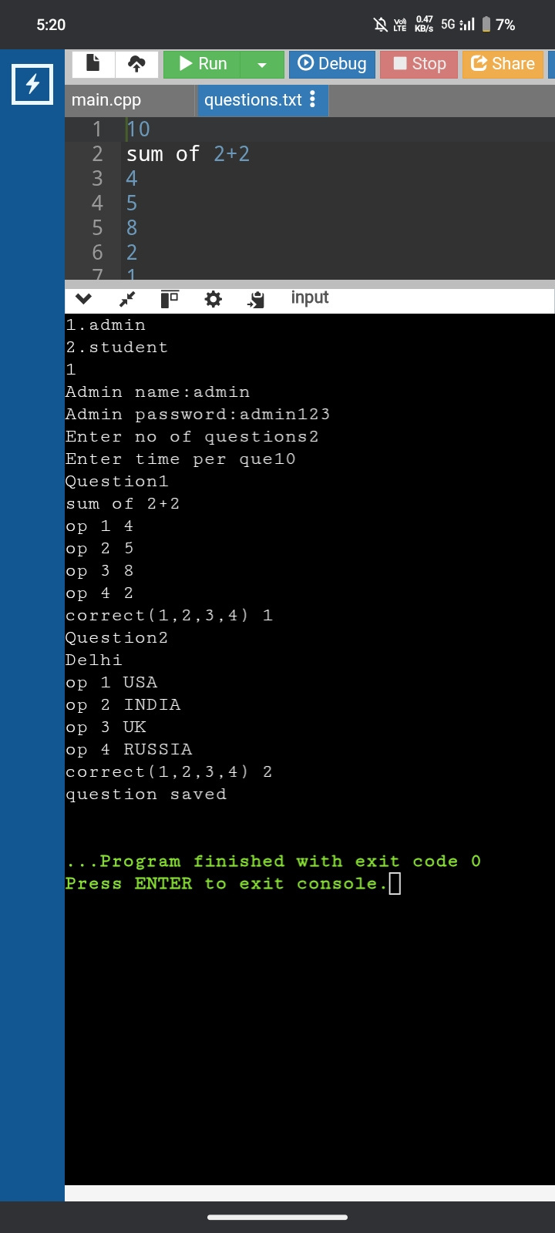
Output 2: Admin Creating Questions
EXPLANATION
User selects option 1 (Admin)
Login: admin / admin123 → SUCCESS
Admin enters: 2 questions, 10 sec each
Question 1: sum of 2+2, correct ans: 1 (option 4)
Question 2: Delhi, correct ans: 2 (INDIA)
Data saved to questions.txt (see top panel)
File format: time + 6 lines per question
Confirmation: 'question saved' displayed

Slide 9
Classes: que & exam
CODE
EXPLANATION
class que{
public:
string q,o1,o2,o3,o4,corr;
void displayque(){...}
};
class exam{
vector<que> questions;
int timeque;
public:
void addquestion(){...}
void loadquestions(){...}
void startexam(){...}
};
que: stores Q text, 4 options, correct ans
displayque() prints formatted question
exam: contains vector<que> (all questions)
timeque: seconds allowed per question
addquestion(): Admin input + file write
loadquestions(): Read from questions.txt
startexam(): Run timed test with scoring

Slide 10
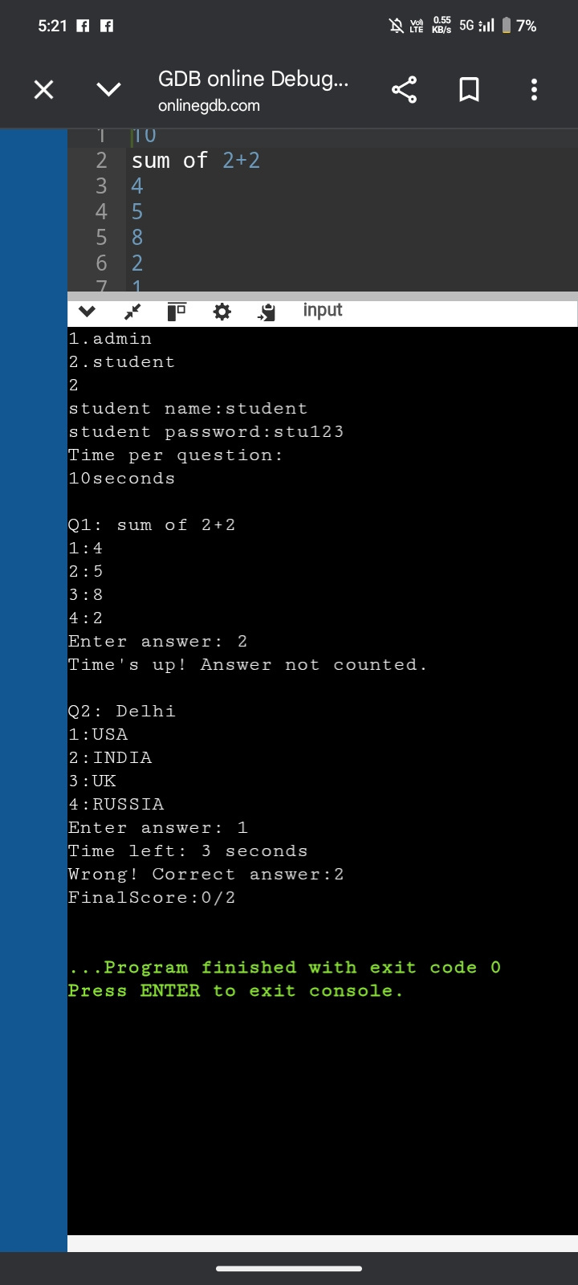
Output 3: Student Taking the Exam
EXPLANATION
Student login: student / stu123 → SUCCESS
Time per question displayed: 10 seconds
Q1: sum of 2+2, student answers '2' (option 5)
Time expired! → 'Time's up! Answer not counted.'
Q2: Delhi, student answers '1' (USA)
Time left: 3 seconds (answered in time)
Wrong! Correct answer: 2 (INDIA)
Final Score: 0/2 (0 correct out of 2)

Slide 11
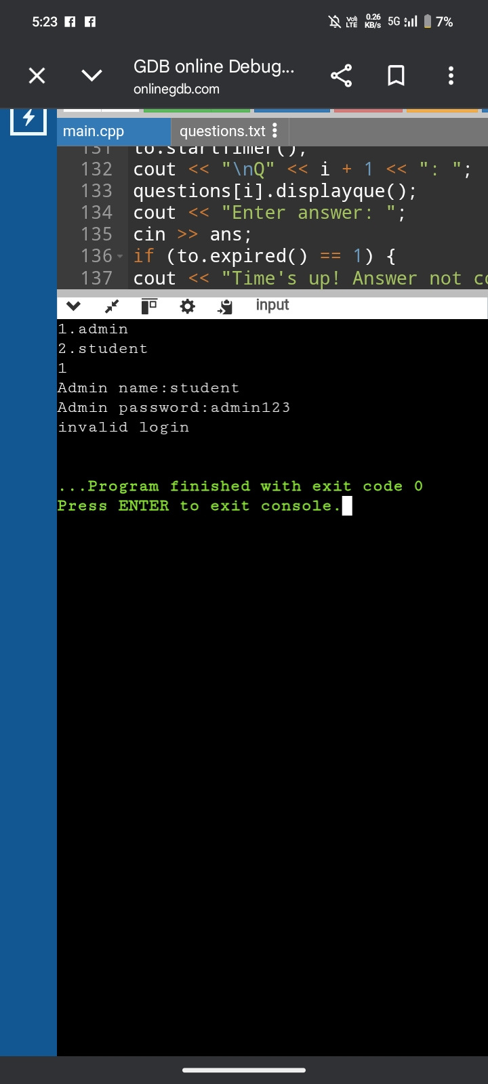
Output 4: Invalid Admin Login
EXPLANATION
User selects option 1 (Admin)
Enters username: student (WRONG!)
Enters password: admin123 (correct password)
BUT username must be 'admin'
Program outputs: 'invalid login'
adminlogin() returns 0, so addquestion() NOT called
Both username AND password must match exactly
Program exits normally (exit code 0)

Slide 12
File Format: questions.txt
Line 1: timeque (seconds per question, e.g., 10)
Then for EACH question (6 lines):
Line 1: Question text
Line 2: Option 1
Line 3: Option 2
Line 4: Option 3
Line 5: Option 4
Line 6: Correct answer (1/2/3/4)

Slide 13
OOP Concepts & Key Features
Encapsulation: Data bundled with methods in classes
File I/O: Persistent storage using fstream library
Dynamic Arrays: vector<que> for flexible question count
Real-time Timer: time_t and time(0) for per-question limits
Authentication: Basic login with hardcoded credentials
Automatic Scoring: Compare answers and track score
Modular Design: Separate classes for timer, user, que, exam

Slide 14
RESULT AND DISSCUSIONS
The Online Examination System was successfully implemented using C++. The system allows admins to create and store questions, and students to attend exams with a timer. Answers are evaluated automatically, and results are displayed instantly. The system reduces manual work and ensures accuracy. Testing shows that it works efficiently for conducting exams in a simple and reliable way.

Slide 15
CONCLUSION
The project successfully automates the examination process and reduces manual effort. It provides quick and accurate results with a user-friendly interface. The system demonstrates effective use of C++ concepts and can be further improved with advanced features like GUI and database integration.

